Slide 1
The state of art in QID finding
Xinhui Xu

Slide 2
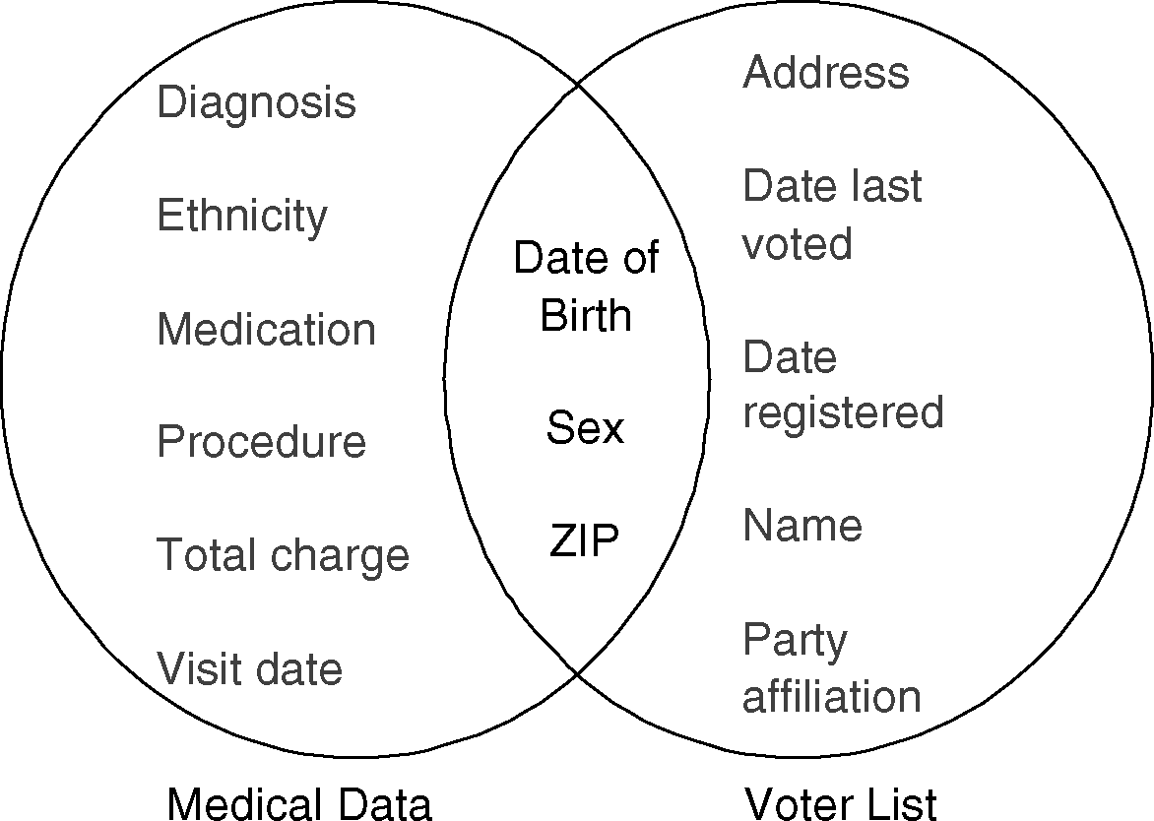
What’s the problem? Privacy!
Linking to re-identify record owner
One tip: 87% of the U.S. population are made unique based on birth, sex and zip code.

Slide 3
Papers Related
[1] Privacy-Preserving Data Publishing: A Survey of Recent Developments, ACM Computing Survey 2010.
[2] Efficient algorithms for masking and finding quasi-identifiers, VLDB 2007.

Slide 4
Linkage Attacks
Record Linkage: a victim is linked to a small number of records in a table
Attribute Linkage: an attacker may not precisely identify the record of the target victim, but could infer his sensitive values from published data table
Table Linkage: foregoing two linkage attack assume the victim’s record is in released table, however sometimes the presence of the victim’s record in released table already reveal the victim’s sensitive info

Slide 5
QID
Privacy leakage through linkage attack by adversaries with background knowledge
QID is a subset of attributes that used to infer the identities of the individuals involved, or used to determine a value of another sensitive field
Adversary infer sensitive info with full identification info (QID values)
The knowledge of which attributes may compose QID is crucial for masking
Notes:
In a relational table

Slide 6
Conventional QID definitions
All the attributes that appear in external sources
K-QID: any combination of values for attributes can be found in no more than k records in a table
Minimum QID: minimum set of attributes
Multiple minimum QIDs
Different definition will cause different privacy leakage

Slide 7
Challenges
Definition of QID remains mostly informal, and different authors seem to have different interpretations of the concept of QID
No definite answer to what attribute values can be obtained by attackers
Approximation method for finding minimum key can be used to find minimum QID, but what if attackers hold more than minimum QID?
If not minimum QID, how can we generally give a definition of “Good Enough QID” and invent a new algorithm to find it?
Notes:
QID is to some extent different from key, the knowledge which can be used to limit the possible candidates by attackers is useful, it’s unpredictable
This kind of knowledge can be attributes not in QID, i.e. non-sensitive attributes or sensitive attributes
It’s application dependent in practice rather than treat it as an automatically process?

Slide 8
Current status
Remain an open issue in QID choosing, almost no related paper focus on identifying good QIDs automatically
Rajeev et al. once proposed a method to determine minimal set of quasi-identifiers, in paper “Efficient algorithms for masking and finding quasi-identifiers”, published in VLDB 2007. (here minimum QID means not including other QIDs)

Slide 9
Other techniques
Rely upon statistical analysis or machine learning approaches
Program analysis
Notes:
analyses those programs reading data from and writing data to a published table

Slide 10
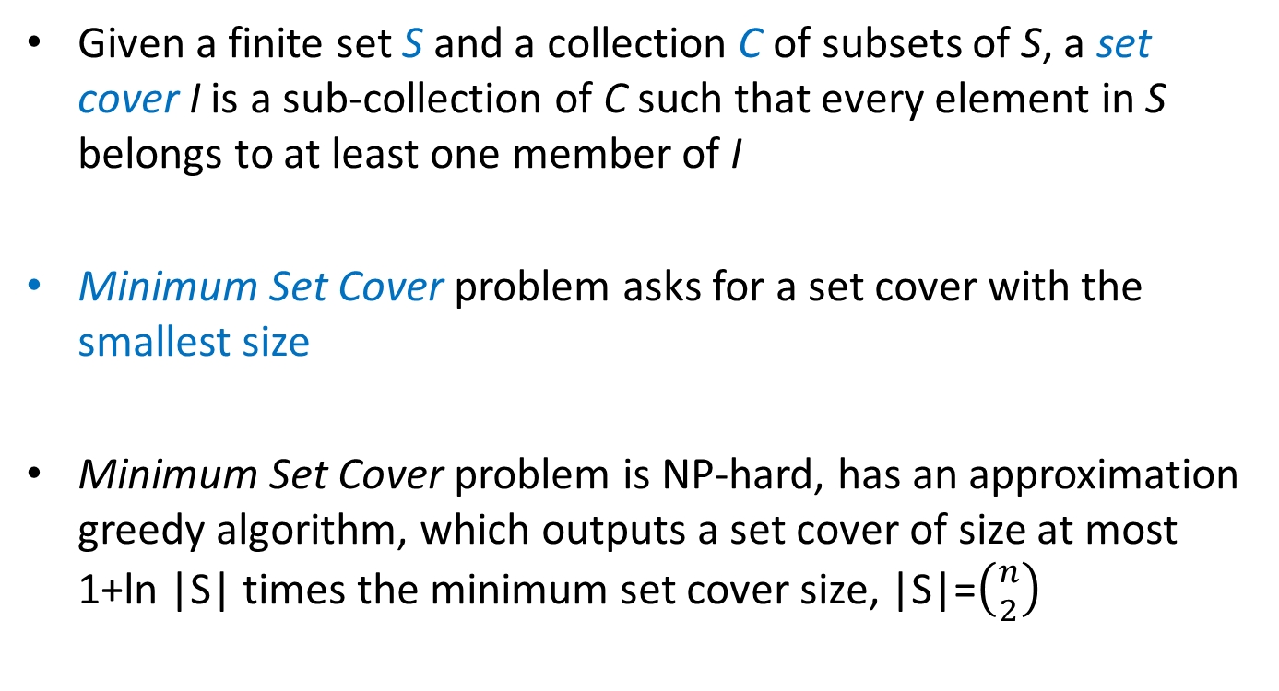
Minimum set cover
Given a finite set S and a collection C of subsets of S, a set cover I is a sub-collection of C such that every element in S belongs to at least one member of I
Minimum Set Cover problem asks for a set cover with the smallest size
Minimum Set Cover problem is NP-hard, has an approximation greedy algorithm, which outputs a set cover of size at most 1+ln |S| times the minimum set cover size, |S|=$\left({n \atop 2}\right)$
Notes:
S={1,2,3,4,5,6}
C=[{1,2},{3,4},{5,6},{1,3,5}]
I=C
While {1,2},{3,4},{5,6} is smaller

Slide 11
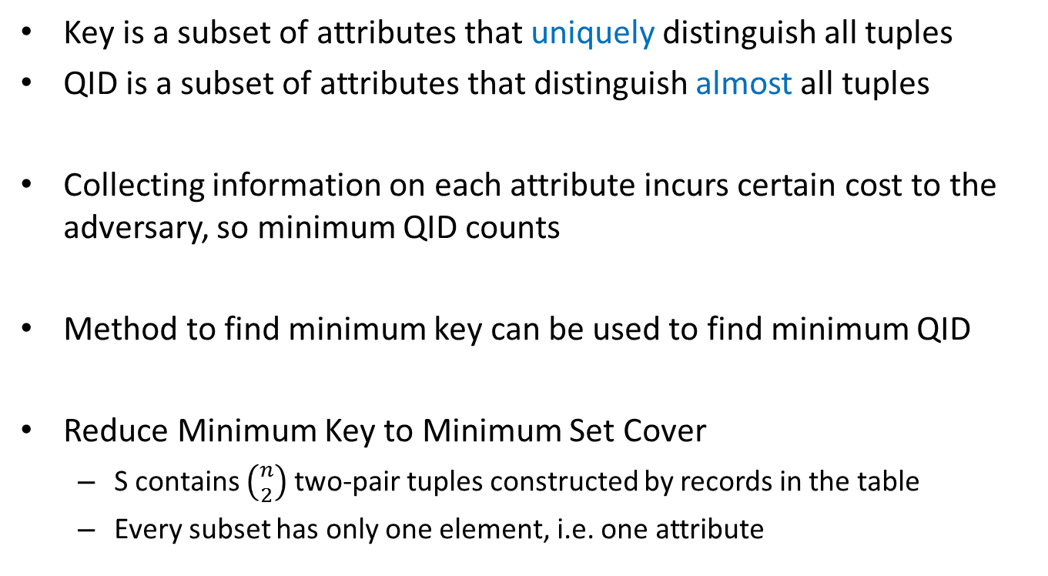
Rajeev’s method to find minimum QID
Key is a subset of attributes that uniquely distinguish all tuples
QID is a subset of attributes that distinguish almost all tuples
Collecting information on each attribute incurs certain cost to the adversary, so minimum QID counts
Method to find minimum key can be used to find minimum QID
Reduce Minimum Key to Minimum Set Cover
S contains $\left({n \atop 2}\right)$two-pair tuples constructed by records in the table
Every subset has only one element, i.e. one attribute

Slide 12
Rajeev’s method(cont.)
Greedy method to Minimum key problem calls for multiple times table scan, not efficient when tables are very large
To solve problem efficiently, Rajeev et al. considered probability and random sampling method
Notes:
In next slide I will give a brief exhibition of one kind of Minimum key discovered by their method

Slide 13
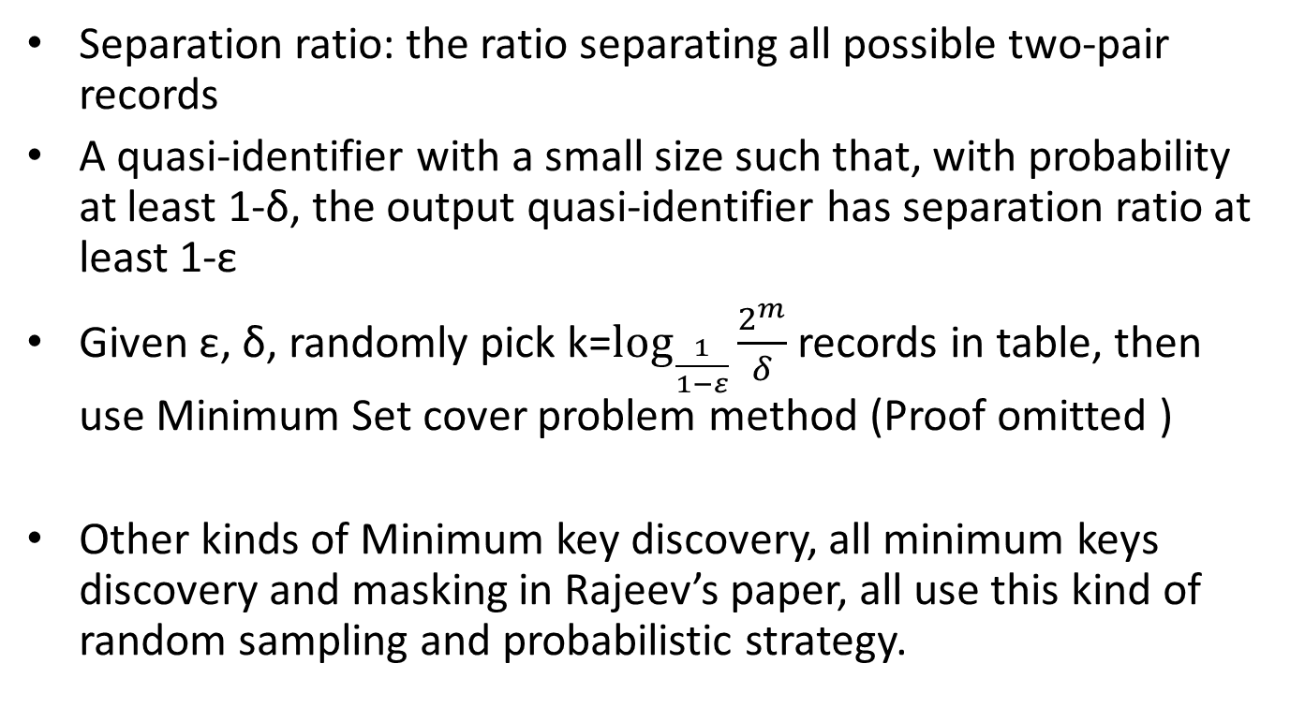
(ε, δ)-Separation Minimum Key
Separation ratio: the ratio separating all possible two-pair records
A quasi-identifier with a small size such that, with probability at least 1-δ, the output quasi-identifier has separation ratio at least 1-ε
Given ε, δ, randomly pick k=$\log_{\frac{1}{1−ε}}{\frac{2^{m}}{δ}}$ records in table, then use Minimum Set cover problem method (Proof omitted )
Other kinds of Minimum key discovery, all minimum keys discovery and masking in Rajeev’s paper, all use this kind of random sampling and probabilistic strategy.
Notes:
0.1
0.1

Slide 14
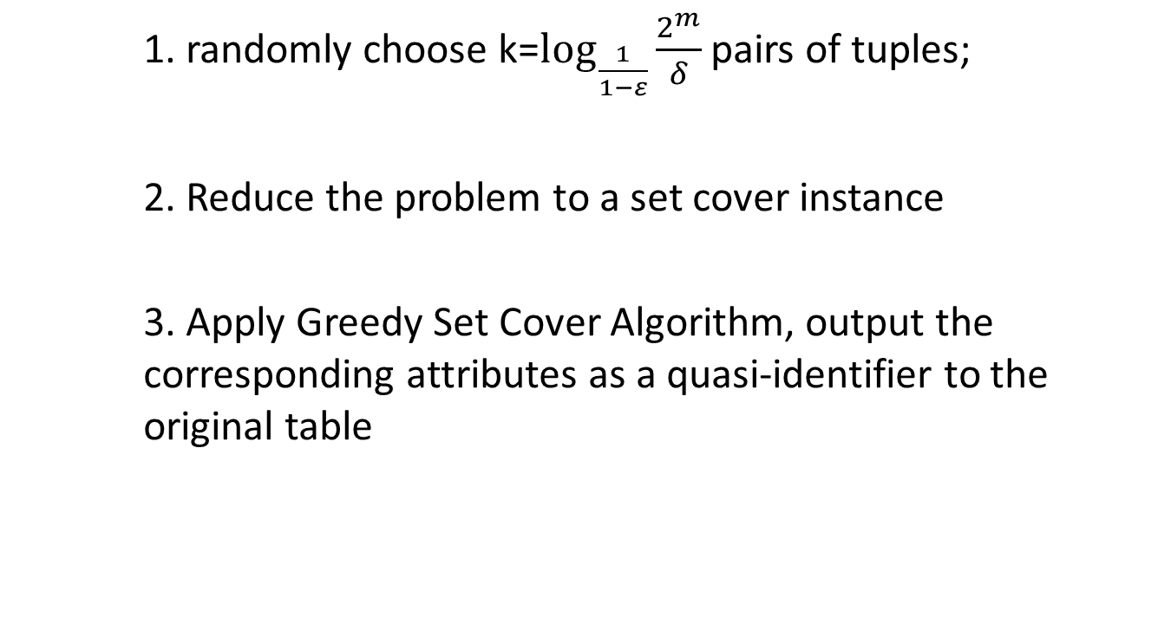
Rajeev’s Algorithm in summary
1. randomly choose k=$\log_{\frac{1}{1−ε}}{\frac{2^{m}}{δ}}$pairs of tuples;
2. Reduce the problem to a set cover instance
3. Apply Greedy Set Cover Algorithm, output the corresponding attributes as a quasi-identifier to the original table

Slide 15
Limitation of Rajeev’s method
Minimal set of QID does not imply the most appropriate privacy protection setting since attackers could potentially have more attribute values

Slide 16
Other related papers
Data cleaning in Data Warehouses
[1] Eliminating Fuzzy Duplicates in Data Warehouses, VLDB 2002.
[2] Robust and Efficient Fuzzy Match for Online Data Cleaning, SIGMOD 2003.
Privacy Disclosure Analysis
[3] Worst-Case Background Knowledge for Privacy-Preserving Data Publishing, ICDE 2007.

Slide 17
Data cleaning in Data Warehouses
Detecting multiple tuples which describe the same real world entity, and correcting errors in data
External data sources usually contain errors: spelling mistakes, missing fields, inconsistent conventions
Domain independent solutions usually rely on similarity functions, like standard textual similarity functions (e.g., edit distance, cosine metric)
Domain specific information complements domain independent solutions

Slide 18
Eliminating Fuzzy Duplicates in Data Warehouses
Focus on detecting multiple tuples which describe the same real world entity
Domain independent solutions rely on standard textual similarity functions between multi-attribute tuples
Result in large numbers of false positive if identifying domain-specific abbreviations and conventions
The notion of co-occurrence can be used for reducing the number of false positives in dimensional tables in a data warehouse, which are usually associated with hierarchies

Slide 19
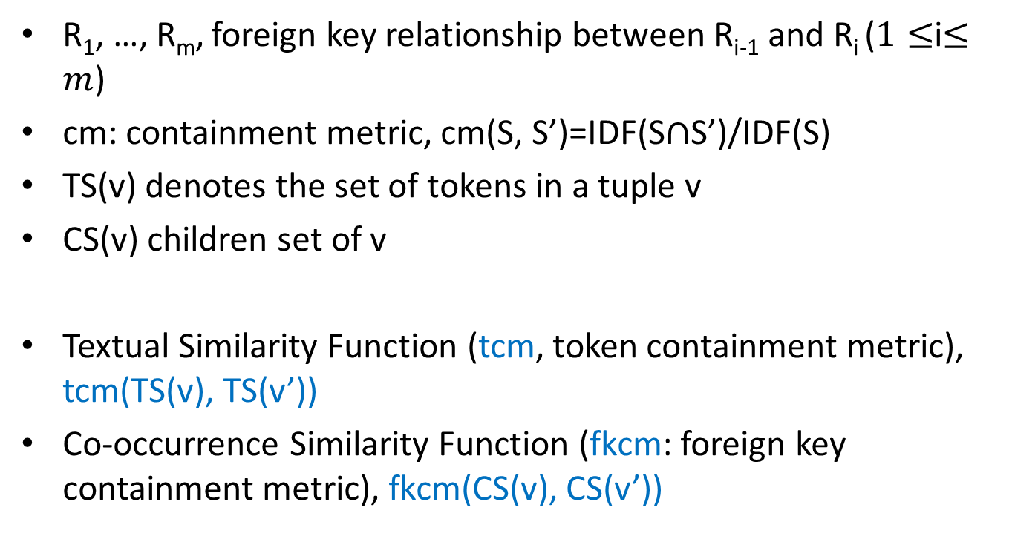
Eliminating Fuzzy Duplicates in Data Warehouses
R₁, …, R_{m}, foreign key relationship between R_{i-1} and R_{i} ($1≤$i$≤m$)
cm: containment metric, cm(S, S’)=IDF(S$∩$S’)/IDF(S)
TS(v) denotes the set of tokens in a tuple v
CS(v) children set of v
Textual Similarity Function (tcm, token containment metric), tcm(TS(v), TS(v’))
Co-occurrence Similarity Function (fkcm: foreign key containment metric), fkcm(CS(v), CS(v’))

Slide 20
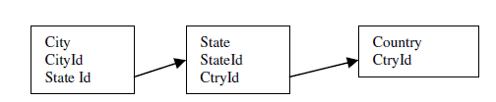
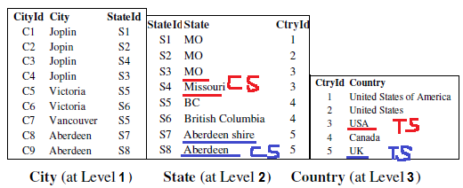
Dimensional tables

Slide 21
Eliminating Fuzzy Duplicates in Data Warehouses
Combination Function
pos(
w_{t}*pos(tcm(v,v’)-tcm_threshold)
+
w_{c}*pos(fkcm(v,v’)-fkcm_threshold)
)
pos(x) = 1, if x > 0, and otherwise -1.
w_{t}=IDF(TS(v))
w_{c}=IDF(CS(v))
Notes:
Token set
Children set

Slide 22
Robust and Efficient Fuzzy Match for Online Data Cleaning
Focus on cleaning incoming tuples, make cleaned tuples match acceptable tuples in reference tables
Propose a new similarity function, develop an efficient fuzzy match algorithm
Fuzzy match similarity(FMS) function:
view a string as a sequence of tokens and associating with weights(IDF) quantifying their importance
minimum cost of “transforming” one tuple into the other through a sequence of transformation operations (replacement, insertion, and deletion of tokens)
the cost of each transformation operation is a function of the weights of tokens involved

Slide 23
Worst-Case Background Knowledge for Privacy-Preserving Data Publishing
Initiate a formal study of the worst case disclosure in a masked bucket with background knowledge
Does not assume the exact background knowledge
Assume bounds on background knowledge in terms of the number of basic units of knowledge
Propose basic implications as an expressive choice for units of knowledge

Slide 24
Worst-Case Background Knowledge for Privacy-Preserving Data Publishing
Computing the probability of a specific disclosure from a given set of k basic implications is intractable
Show how to efficiently determine the worst-case over all sets of k basic implications

Slide 25
Conclusion & Discussion
Remains an open issue
An automatic process , or application dependent solution, which is better?
Depend on application requirements in MS, make QID definition acceptable first, then find solutions
Or we just move towards masking techniques? ☺

Slide 26
Thanks!

Slide 27
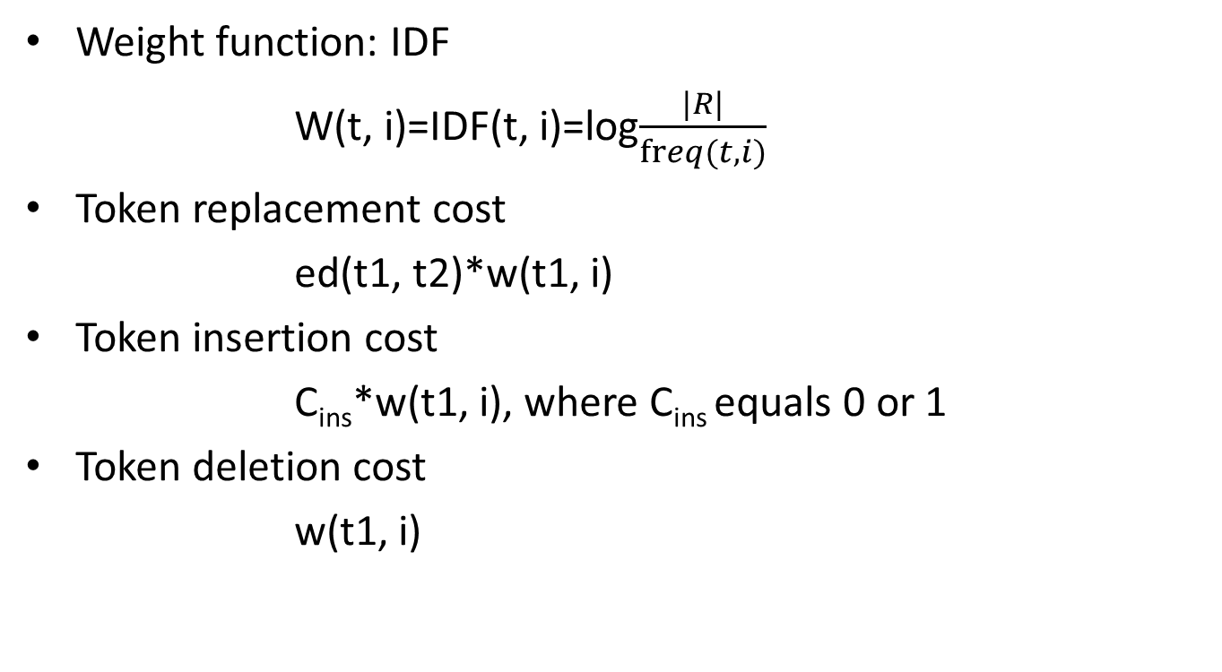
Robust and Efficient Fuzzy Match for Online Data Cleaning(omitted)
Weight function: IDF
W(t, i)=IDF(t, i)=log$\frac{|R|}{freq(t, i)}$
Token replacement cost
ed(t1, t2)*w(t1, i)
Token insertion cost
C_{ins}*w(t1, i), where C_{ins} equals 0 or 1
Token deletion cost
w(t1, i)

Slide 28

Robust and Efficient Fuzzy Match for Online Data Cleaning(omitted)
Transformation cost: tc(u[i], v[i])
tc(u,v) = $\sum_{i}{tc(u\left[i\right], v\left[i\right])}$
Fuzzy Similarity Match
fms (u, v) = 1-min($\frac{tc(u, v)}{w(u)}$, 1.0)

